Slide 1
Safe Handling & Storage of Materials
March 2018
Notes:
Safe Handling & Storage of Materials

Slide 2

Hazards of Manual Material Handling
Be Aware: Injury can occur from manual material handling tasks, however following safe work practices can prevent these types of injuries.
For example:
Soft tissue sprains, strains and tears
Bruises and contusions
Cuts and punctures
crushing injuries or amputations
Notes:
Please be aware that Injury can occur from manual material handling tasks. However, following safe work practices can prevent these types of injuries from occurring. For example:
Soft tissue sprains, strains and tears
Bruises and contusions
Cuts and punctures
crushing injuries or amputations

Slide 3
MANUAL MATERIALS HANDLING
Part 1
Notes:
Manual Material Handling

Slide 4
Planning
Before moving materials:
Plan the lift and the route
Identify possible hazards, limitations, route safety, and final placement
Evaluate the weight and shape of the load
Consider:
Is Personal Protective Equipment needed?
Should the load be broken up into multiple moves?
Is assistance required from a mechanical device or coworker?
Will other workers or students be affected?
Notes:
Planning
Before moving materials, it is important to plan the task, taking the time to think through each step.
Be sure to plan both the lift and the route in order to identify possible hazards along the way, Personal or equipment limitations, route safety, and final placement of the load
Be sure to evaluate the weight and shape of the load and consider:
Is Personal Protective Equipment needed for this task?
Should the load be broken up into multiple moves?
Is assistance required from a mechanical device or coworker?
OR
Will other workers or students be affected during the move?

Slide 5
The Load
Reduce the weight of the load by decreasing the:
size of the object (e.g. buy smaller sizes)
weight of the container (e.g. plastic is lighter than steel)
capacity of containers
load in the container
Breaking it down to multiple, smaller loads
Notes:
The Load
One preventative measure that can be taken to prevent injury can be to reduce the weight of the load.
For example, you can decrease:
The size of the object (for example. buy smaller sizes)
The weight of the container (for example, plastic is lighter than steel)
The capacity of the container
The load in the container
or, Breaking it down to multiple, smaller loads

Slide 6
The Load Cont…
Decrease the load on the employee by:
limiting the number of objects that are handled during the day
rotating tasks
Designating heavier or awkward loads as team lifts (ie. 2 or more persons)
Changing size and shape of load so employee can get closer the load’s centre of gravity
Notes:
Furthermore, you can decrease the load by:
limiting the number of objects that are handled during the day
rotating tasks
Designate heavier or awkward loads as team lifts (with 2 or more persons)
Change the size and shape of the load so you can be closer to its centre of gravity

Slide 7
Pushing and Pulling
Make loads easier to push/pull by using:
Carts, hand trucks and dollies with large diameter casters and good bearings
Grips/handles on loads or mechanical aids, placed to provide optimal push force and prevent awkward postures
Notes:
Pushing and Pulling
Make loads easier to push or pull by using:
Carts, hand trucks and dollies with large diameter casters and good bearings
Use grips and handles available, typically placed to provide optimal push force and prevent awkward postures

Slide 8
Use of Hand Trucks
Includes: wheelbarrows, dolly trucks and 2-wheeled hand trucks)
2-wheeled hand trucks should be equipped with brakes
Heavy objects should be loaded before lighter ones
Keep the load as low as possible as not to obstruct your view
Use proper lifting techniques
Push & balance truck while always walking forward
Don’t hold the truck in place with your foot
Notes:
Use of Hand Trucks:
This Includes: wheelbarrows, dolly trucks and 2-wheeled hand trucks
When using these mechanical aids, keep the following in mind:
2-wheeled hand trucks should be equipped with brakes
Heavy objects should be loaded before lighter ones
Keep the load low as not to obstruct your view
Use proper lifting techniques
Push & balance truck while always walking forward
Don’t hold the truck in place with your foot

Slide 9
Key Points
Push rather than pull
Avoid overloading – limit the load pushed or pulled at one time
Do not exceed mechanical equipment load capacities
Ensure the load does not block vision
Never push one load and pull another at the same time
Notes:
Reviewing some of the Key Points:
Push rather than pull to decrease stress on the body
Avoid overloading – limit the load pushed or pulled at one time even if it means making multiple moves.
Do not exceed mechanical equipment load capacities
Ensure the load does not block your vision
Never push one load and pull another at the same time. - Your Health and safety is more important than anything that needs to move from here to there.

Slide 10
CARRYING AND HOLDING
Part 2
Notes:
Carrying and Holding

Slide 11
Reduce the Force
Make the material movement a pushing or pulling task
Use mechanical devices (carts, dolly)
Use portable containers in which to place awkward loads
Use grips or handles on loads
Limit the distance the load is moved over
Notes:
Reduce the Force
You can reduce the force required to move materials by:
Make the material movement a pushing or pulling task rather than carrying the load
Using mechanical devices that are appropriate for the task (such as carts or dollies)
Use portable containers in which to place awkward loads to help secure the items
Use grips or handles on loads when available
Limit the distance the load is moved over

Slide 12


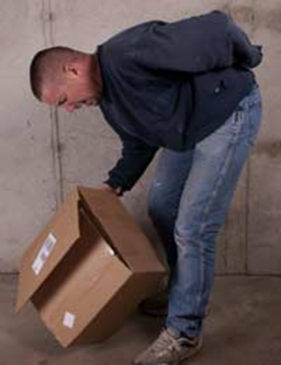
Lifting
To decrease your risk of a back injury, you should avoid:
Twisting with a load
Hurrying
Carrying to much at once
Lifting with your back instead of bending at the knee
Notes:
Lifting
To decrease your risk of a back injury, you should avoid:
Twisting or jerking movements while carrying a load
Hurrying
Carrying to much at once
Lifting with your back instead of bending at the knee

Slide 13
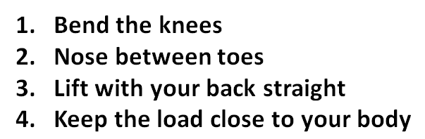
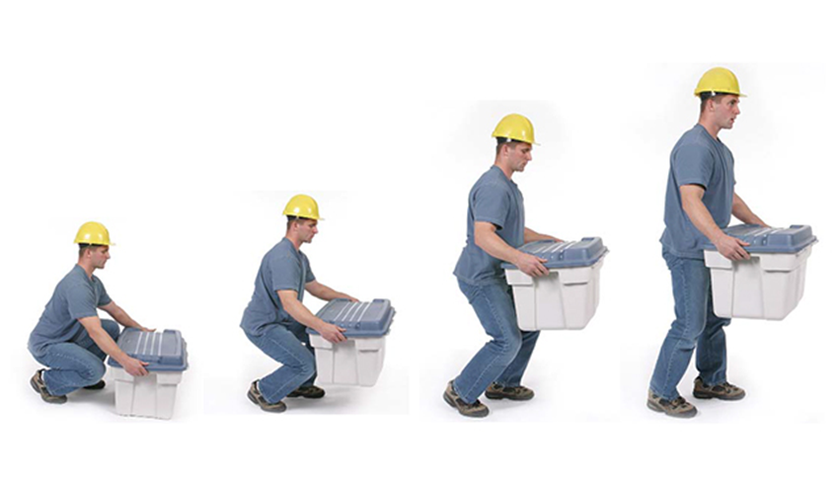

Proper Lifting
Notes:
Proper lifting
Now let’s review proper lifting technique:
Bend at the knees instead of bending forward from the hip
Keep your nose between your toes - to avoid twisting
Lift the load with good back posture - a straight back and core muscles tightened.
And keep the load close to your body to avoid overreaching
Always remember to test the load before the lift!

Slide 14
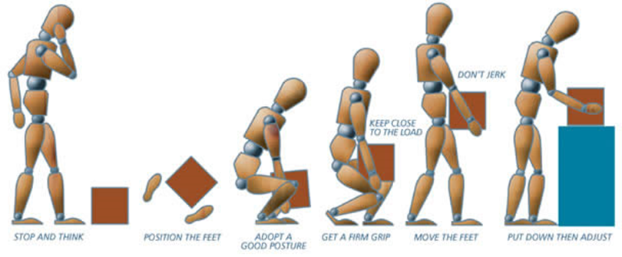
Proper Lifting Cont...
Notes:
Here is another good visual for proper lifting technique:
Stop and think about your lifting plan and test the load to ensure you can complete the task safely
Position your feet
Adopt a good posture for lifting
Ensure you have a good grip on the load
Keep the load close to the body
Avoid twisting and jerking movements as you carry the load.
Finally, place the load down safely at your final destination

Slide 15
ENVIRONMENTAL FACTORS
Part 3
Notes:
Environmental Factors

Slide 16
Optimal Environment
In a hot environment - take breaks as necessary away from the heat
In a loud environment - ensure lifting instructions can be heard by all team members
Ensure that:
Lighting levels are adequate
Layout of the work area provides better access to the load
Aisles are free of obstacles
Notes:
Optimal Environment
There are other factors to consider that contribute to safe material handling.
For example, In a hot environment - take breaks as necessary away from the heat
In a loud environment - ensure lifting instructions can be heard by all team members involved
You should also be sure that:
Lighting levels are adequate throughout your route
The Layout of the work area provides better access to the load
And that Aisles are free of obstacles

Slide 17
GENERAL PRECAUTIONS
Part 4
Notes:
General Precautions

Slide 18
General Precautions
Test the weight of the load so it can be lifted securely … if not, make adjustments
Grip load securely
Protect hands from pinch points
Get help with awkward or heavy loads
Practice good team lifting
Always use mechanical devices and aids provided and be sure they are in good condition
Don’t rush or cut corners
Notes:
To review, the following are some general precautions to take for safe material moving:
Test the weight of the load so it can be lifted securely … if not, make adjustments
Grip the load securely
Protect hands from pinch points
Get help with awkward or heavy loads
Practice good team lifting
Always use mechanical devices and aids provided and be sure they are in good condition
Don’t rush or cut corners

Slide 19
Storing Materials
Part 5
Notes:
Storing Materials

Slide 20
Storage
Injury or damage could result if materials are not stored properly.
Do not obstruct
aisles, stairs or exits
Fire extinguishers, eyewash stations, emergency showers or first aid kits
Keep materials clear of
sprinkler heads, smoke sensors, electrical panels and heat sources
Notes:
Storage
Injury or damage could result if materials are not stored properly.
Stored items should not obstruct
aisles, stairs or exits as well as...
Fire extinguishers, eyewash stations, emergency showers or first aid kits
Be mindful to keep materials clear of
sprinkler heads, smoke sensors, electrical panels and heat sources

Slide 21
Shelving
Shelving units taller than 4ft should be secured to the wall
Materials stored on shelves should be secure to prevent from sliding, rolling, falling or collapsing
Store heavy items on lower shelves up to waist height
Do not overload a shelf - watch for bowing
Notes:
Shelving
As a general rule, Shelving units taller than 4ft should be secured to the wall to prevent tipping.
Materials stored on shelves should be secure to prevent from sliding, rolling, falling or collapsing
Store heavy items on lower shelves up to waist height
Do not overload a shelf - If a shelf is starting to show signs of bowing, The load needs to be lightened.

Slide 22
Stacking
Stack loads straight and evenly
Correct unbalanced loads when you see it
Consider placement:
Is there enough space?
Stacking materials near operating machinery may make the load subject to vibration and loss of stability
Notes:
Stacking
When storing larger quantities of materials, there are some considerations to remember
Stack loads straight and evenly so the stack is secure
Correct unbalanced loads when you see it to prevent a collapse or fall
Consider placement:
Is there enough space to store all of the material in one place safely?
Be aware that Stacking materials near operating machinery may make the load subject to vibration and loss of stability

Slide 23
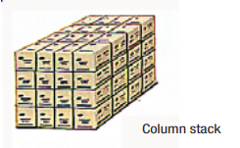
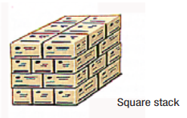
Stacking Styles
Depending on the space available and the item to be stored, there are different ways to stack materials:
Column: Single articles placed one above the other
Square: Any stack with vertical sides
Notes:
Stacking styles
Depending on the space available and the item to be stored, there are different ways to stack materials:
In Image 1 you will see a Column stack with Single articles placed one above the other
Image 2 shows a Square stack where items are not in columns but the stack still has all vertical sides

Slide 24
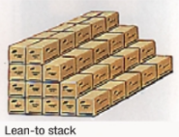
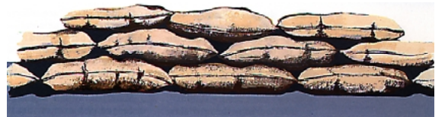
Stacking Styles Cont...
3) Lean-to: “stepped” on one side, and vertical on three sides. The stack does not actually lean against a support.
4) Bagged Goods: Place the first row with the bags laying flat, and continue interlocking with the following tiers.
Notes:
Image 3 shows a lean-to stack where one side is stepped and vertical on the other 3 sides. Please note that the stack does not actually lean against a support.
Image 4 shows a stack with bagged goods. The first row should be laid as flat as possible, with the following tiers interlocking.
Any type of stack should not reach unstable heights.

Slide 25
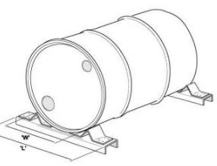
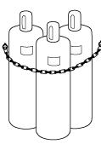
Stacking Styles Cont...
5) Cylindrical items: If stacked on their sides, wedges (or chocks) should be fixed to the sides to prevent rolling.
6) Gas cylinders: use restraining chains to secure upright cylinders.
Notes:
Image 5 shows an example of storing cylindrical items on its side. It should be stored so that it is secure from rolling by using wedges or chocks
In Image 6, items such as gas cylinders that are required to be stored upright need to be secured with a chain to prevent from tipping.

Slide 26
Stacking Styles Cont...
7) Sheet Materials:
Consider if the material can be laid flat
If stacking up on end, you must support the load to prevent tipping. Large amounts of sheet material should NOT be stored this way together.
Protect sharp edges to prevent injury to others in the area
8) Long/tall items (i.e. boards/poles):
Should be stored flat along the ground unless it can be secured upright to prevent tipping (ex. Use of chain or strap)
Notes:
When stacking sheet materials,
Consider if the material can be laid flat
If stacking up on end, you must support the load to prevent it from tipping. Large amounts of sheet material should NOT be stored this way together.
Be sure to Protect exposed sharp edges to prevent injury to others in the area
For Long or tall items (such as boards or poles):
These Should be stored flat along the ground unless it can be secured upright to prevent from tipping (for example with the Use of a suitable chain or strap)

Slide 27
Special Note: Mezzanines
Not all mezzanines are designed to hold storage as there may be a risk of falling or collapse.
If storage is allowed on mezzanines, keep stacked materials below the half-wall height to ensure it does not fall over into the work space below.
Notes:
Special note regarding Mezzanines:
Not all mezzanines are designed to hold storage as there may be a risk of falling or collapse.
If storage is allowed on mezzanines, keep stacked materials below the half-wall height to ensure it does not fall over into the work space below.
Furthermore, if the mezzanine has a hand or guardrail for the protected edge, loose items or liquids should not be stored on the mezzanines as these items could be kicked or split over the edge.

Slide 28
Conclusion
Part 6
Notes:
Conclusion

Slide 29
Be sure to talk to your Supervisor if you find a hazard to report or you are unsure of a task.
Completing the task while preventing injury is the goal, however it is important to report any workplace injury to your Supervisor for investigation and proper documentation.
Thank you
Notes:
Be sure to talk to your Supervisor if you find a hazard to report or you are unsure of any task.
Completing the task while preventing injury is the goal, however it is important to report any workplace injury to your Supervisor for investigation and proper documentation.
Thank you

