Slide 1




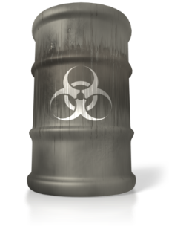
WHMIS: Workplace Hazardous Material Information System

Slide 2


OVERVIEW
The Workplace Hazardous Materials Information System (WHMIS) provides information about many hazardous materials used in the workplace. WHMIS calls these hazardous materials controlled products.
Under WHMIS, workers have the right to receive information about each controlled product they use – its identity, hazards, and safety precautions. The goal of WHMIS is to reduce injury and disease by communicating specific health and safety information about controlled products so that the information can be used to reduce exposure to hazardous materials.

Slide 3





Federal and Provincial Legislation
The Federal WHMIS legislation came into effect on October 30, 1988 under the Hazardous Products Act and four other pieces of federal legislation.
1
2
Controlled Products
Ingredient Disclosure List
3
4
Hazardous Materials Information Review Act
Hazardous Materials Information Review
WHMIS came into effect in Ontario on October 31, 1988 as a Regulation under the Occupational Health and Safety Act (OSHA). In Ontario, the WHMIS Regulation applies to all workplaces that are covered by the OHSA and is enforced by the Ministry of Labour. The federal workplaces are inspected by Labour Canada, which enforces WHMIS under its jurisdiction.

Slide 4




3 Basic Elements of WHMIS
WHMIS LABELS
Labels on controlled products alert workers to the identity of the product, hazards, and precautionary measures.
MATERIAL SAFETY DATA SHEETS (MSDS)
Technical bulletins which provide detailed hazard and precautionary information.
WHMIS TRAINING AND EDUCATION
The employer provides education and training for workers so that they can work safely with and near controlled products. Workers need to know how WHMIS works, the hazards of controlled products in their workplace, and the safe work procedures they must follow.

Slide 5

Key WHMIS Participants
Suppliers
  Classify all controlled products
  Supply proper labels and MSDS
  Keep information on labels and MSDS current
Employers
  Educate and train workers
  Provide safe work procedures
  Ensure availability of proper up-to-date labels and MSDS
Workers
  Understand content and significance of labels and MSDS
  Follow safe work procedures and WHMIS requirements
  Notify employers about problems with labels and MSDS

Slide 6
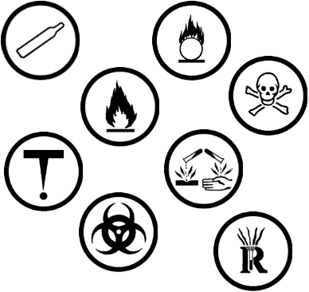
WHMIS ELEMENTS
WHMIS controlled products are classified by their hazard. There are six hazard classes and eight hazard symbols that identify the specific hazards (there are three symbols in Class D).
The eight hazard symbols identify the specific hazards of controlled products.

Slide 7

CLASS A: Compressed Gas
Gas under pressure
Examples:
Butane, propane, acetylene, and fire extinguishers
Hazards:
If a pressurized container is punctured because it is dropped or exposed to excessive heat, the exploding fragments or rocket-like projectiles present a serious physical hazard. Heat may cause container to explode. Container may explode if dropped.

Slide 8

CLASS B: Flammable and Combustible Materials
May catch fire or explode
Examples:
Acetone, isopropyl alcohol, stoddart solvent
Hazards:
Flammables are more dangerous than combustibles because they ignite more easily. During use, they must be kept away from ignition sources such as sparks or open flames. When not in use, they must be stored in fire-resistant cabinets or other specified storage areas.

Slide 9

CLASS C: Oxidizers
Products causing or contributing to the combustion of other materials
Examples:
Hydrogen peroxide, potassium nitrate, sodium chlorate
Hazards:
Oxidizing materials greatly increase the risk of fire if they come in contact with materials that can burn. They should never be stored near flammable or combustible materials.

Slide 10



CLASS D: Poisonous and Infectious Materials
This class has 3 divisions: D1, D2 and D3
D1:
Materials causing immediate and serious toxic effects
D2:
Materials Causing Other Toxic Effects
Bio hazardous Infectious Material
D3

Slide 11

CLASS D1: Materials Causing Immediate and Serious Toxic Effects
Poisonous, may be fatal
Examples:
Arsenic, methylene chloride, formaldehyde
Hazards:
May be fatal if inhaled, swallowed or absorbed through skin
May burn skin or eyes upon contact

Slide 12
CLASS D2: Materials Causing Other Toxic Effects
Poisonous, but not immediately dangerous to health
Chronic health effects on body organs, cardiovascular or nervous system
Examples:
Carcinogens (asbestos, crystalline silica, benzene) sensitizers (methyl methacrylate) embroyotoxin (xylene)
Hazards:
Repeated exposure may cause death or permanent injury.
May be a skin irritant or sensitizer causing allergic reaction.
May cause birth defects, cancer, reproductive problems, or impairment of body organs and systems.

Slide 13

CLASS D3: Bio Hazardous Infectious Material
May cause serious disease, resulting in death or illness
Classified as Risk Groups II, III or IV as defined by the Medical Research Council of Canada
Examples:
Commercial cultures containing infectious organisms such as HIV, Ebola, and Hepatitis B
Hazards:
Microorganisms (includes viruses, bacteria, fungi) can cause disease in persons and animals. They may be present in cultures. Products containing bio hazardous infectious materials may be found in laboratory and research facilities associated with the medical or agricultural sectors.

Slide 14
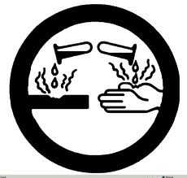
CLASS E: Corrosive Materials
Caustics or acids causing severe irritation and burns to skin or eyes
Examples: sodium hydroxide, bleach, hydrochloric acid, hydrofluoric acid
Hazards:
Corrosive materials can cause permanent damage (e.g., burns) to skin and eyes.
May be harmful if inhaled.
May eat through metal.

Slide 15

CLASS F: Dangerously Reactive Materials
Products that can undergo dangerous reaction if subject to heat, light, pressure, shock, water, air
Examples:
hydrogen cyanide, vinyl acetate, chlorine dioxide
Hazards:
Products in this class are very unstable . They can undergo vigorous polymerization reaction on their own, or become self-reactive when exposed to shock or to increase in pressure or temperature. It also includes products that react vigorously with water to release a toxic gas.

Slide 16
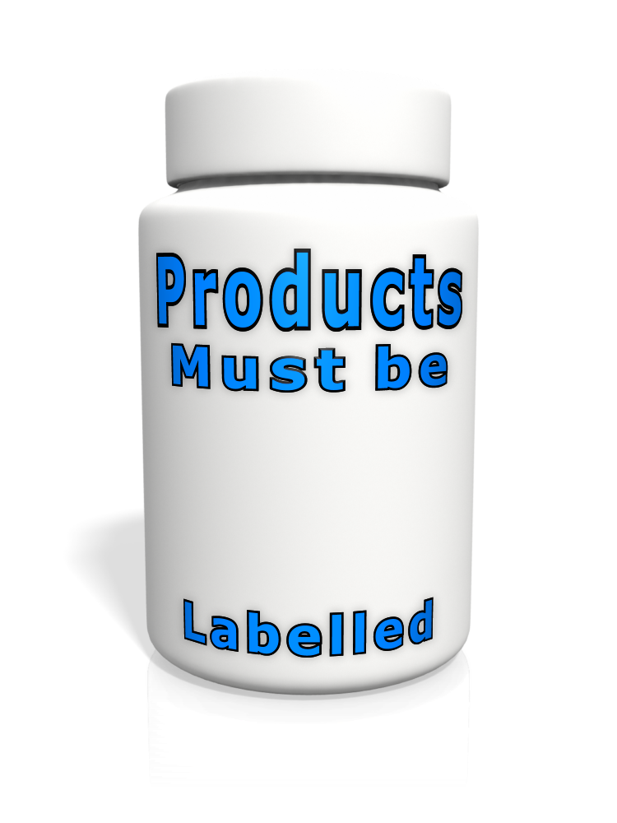
WHMIS Labels
The purpose of labels is to alert workers to the main hazards of controlled products and provide instructions for safe handling, and to direct workers to the MSDS for more information.
All WHMIS controlled products must be labelled
There are 2 types of WHMIS Labels
  Supplier Labels
  Workplace Labels
Other means of identification
  placards, warning signs, colour codes
Labels alert workers to hazards and safe handling instructions

Slide 17
Supplier Labels
Supplier Labels contain the following:
Product name
All information must be disclosed in English and French within a hatched border
Hazard symbols
Risk phrases
Precautionary measures
First aid measures
Supplier identifier
Reference to MSDS
Suppliers must provide supplier labels on containers of all controlled products sold or imported for use in the workplace.
Supplier labels will show seven types of information within the WHMIS hatched border.
The label must be clearly separated by a border to stand out from the container itself and other markings on the container (i.e., the size of the label should be appropriate for the size of the container).

Slide 18
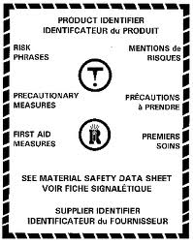
Acceptable Format for the Supplier Label
Product Identifier
Hazard Symbol(s)
Risk Phrases
Precautionary Statement(s)
First Aid Measures
Supplier Identifier
Reference to the MSDS
Hatched Border

Slide 19
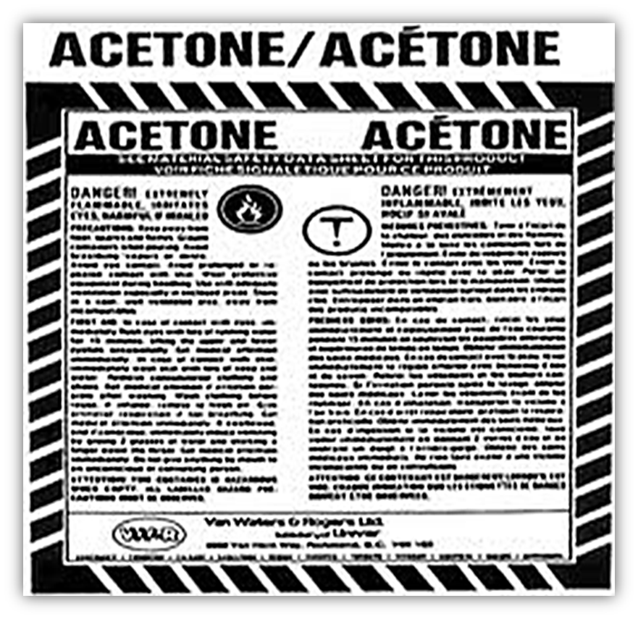
Supplier Label Example

Slide 20

Workplace Labels
Workplace labels are required on containers of controlled products produced on site, and on secondary containers where the product has been transferred from the original container.
Workplace labels are applied to:
Secondary containers
Containers of products received in bulk
Employer-purchased products
Containers with missing or illegible supplier labels
Workplace labels contain the following:
Product name
Safe handling procedures
Reference to the MSDS

Slide 21
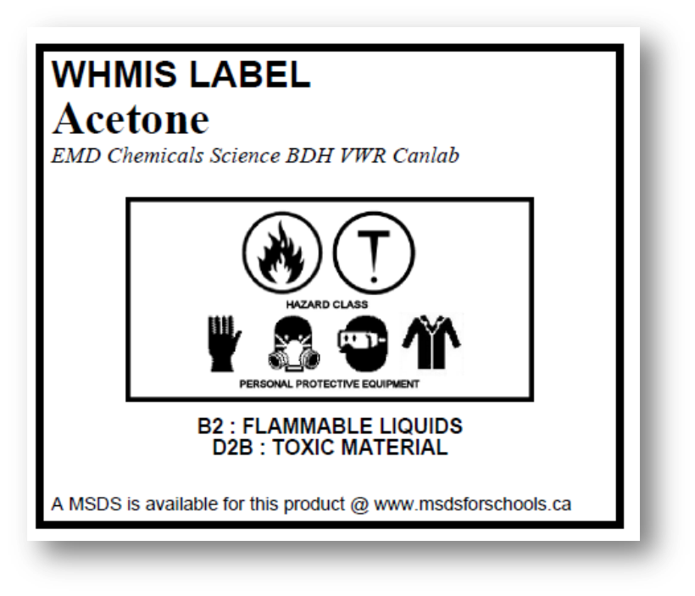
Workplace Label Example

Slide 22
MSDS Information
A Material Safety Data Sheet is a technical bulletin that provides specific hazard information, safe handling information, and emergency procedures for a controlled product. Since the MSDS contains detailed health and safety information specific to each controlled product, it should be used as a key source of information for developing training programs and safe work procedures. It is also a valuable reference source of health and safety information for workers, health and safety committees, and emergency service personnel.
The MSDS must be made available and accessible to all workers.

Slide 23
Material Safety Data Sheet (MSDS)
A technical document providing information on a controlled product, for example:
Hazardous ingredients
Hazards (fire, explosion, reactivity)
Health effects of exposure (acute and chronic)
Hazard evaluation related to storage and handling
Measures to protect workers
Emergency procedures
Must be current (no more than 3 years old), complete, and readily available to workers

Slide 24
Where to Find and MSDS
Employers may use an electronic database to store MSDSs. In this case, it is essential that workers are provided information on accessing such a database to retrieve an MSDS. A hard copy of the MSDS should always be on hand when working with a controlled product in case electronic files are not accessible (e.g., the system is down).
Provides detailed information on the hazards of a controlled product
An important element for developing safe work procedures and control measures
A key element of worker education and training
Halton District School Board uses “MSDS Request” on MyHDSB to store electronic copies of all MSDS. Link: http://www.msdsforschools.ca/

Slide 25




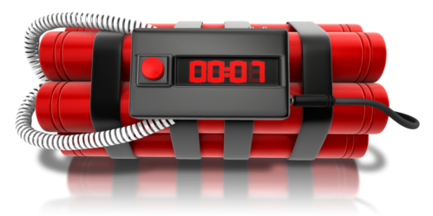
Partial Exemptions
Some products are already covered by other labelling legislation and do not require WHMIS labels and MSDSs. However, Provincial legislation requires employers to educate and train workers about the hazards of partially exempt products, and safe work procedures. Partially exempt products still require Workplace Labels.
No WHMIS Supplier Label and MSDS Required
Education & Training and Workplace Labels Required
Examples:
Some Consumer Products
Cosmetics
Food and Drugs
Medical Devices
Radioactive Substances
Pesticides
Explosives

Slide 26



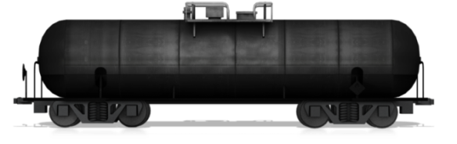
Complete Exemptions
Some products are completely excluded from both Federal and Provincial WHMIS requirements. However, workers must be advised of hazards and be trained in safe handling procedures, as required under other provisions of the Occupational Health and Safety Regulation.
None of the WHMIS Requirements Apply
OH&S Regulation Applies
Examples
Wood and Products made of Wood
Manufactured Articles
Tobacco and Tobacco Products
Hazardous Wastes
Goods Handled Under TDG
Hazardous materials in Transport

Slide 27


WHMIS and Consumer Products
Consumer products are typically packaged and used for personal and household purposes. Suppliers and employers do not have to comply with the WHMIS label and MSDS requirements for consumer products, but workers must understand the hazards and safe use of them. Although not legally required, most consumer products will have an MSDS available.
The obligation includes:
Ensuring that the worker has read and understood the consumer product labels.
Ensuring that the worker would recognize the different consumer product labels.
Ensuring that training is provided for the use, handling, storage and disposal of the consumer product(s).

Slide 28

WHMIS and Consumer Products
Partial exemption of WHMIS applies to the following conditions:
The product must be packaged in a size normally available to consumers in a retail outlet.
The product must be available to the general public; wholesale outlets are not considered to be available to the public.
The product must be labelled to comply with the requirements for hazardous consumer products.
Health and safety precautions must still be taken.
The employer’s training obligations apply to any consumer product containing controlled substances used in a workplace.

Slide 29
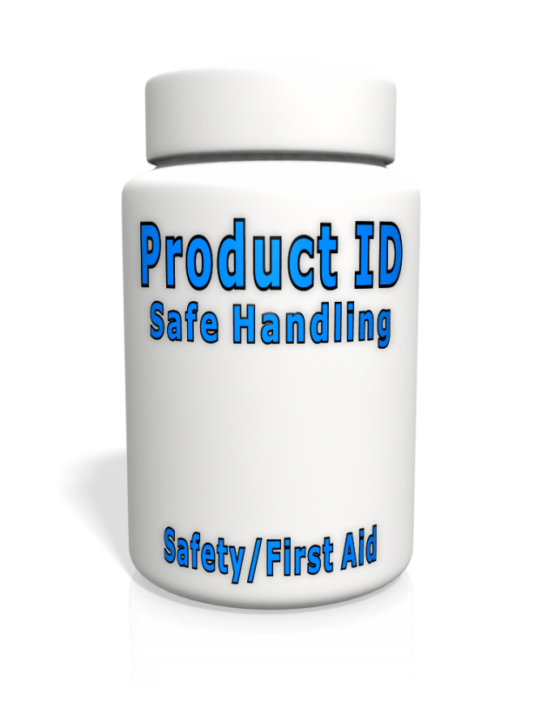
Consumer Product Labels
Labels on consumer products must appear in both English and French.
Hazard information must be clearly separated from the rest of the container by a border.
Most of the labels on products for consumer use sold in Canada meet the criteria set out for WHMIS workplace labels, namely:
The product is identified and the supplier / manufacturer’s name and address are included
Information is given on the safe handling of the product
Safety information is on the label, including: hazard warnings, instructions and directions for First Aid.

Slide 30
Consumer Product Categories and Symbols
Category 1: Toxic or Poisonous Substances
The symbol used for all toxic materials is the skull & crossbones inside an octagonal border. The 8-sided border indicates “STOP” and take precautions listed on the label.
Category 2: Corrosive Substances
The symbol used for all corrosive materials is the hand skeleton inside an octagonal border. The 8-sided border indicates “STOP” and take precautions listed on the label
Category 3: Flammable substances
The symbol used for all flammable materials is a flame inside an octagonal border. The 8-sided border indicated “STOP” and take precautions listed on the label.
Category 4: Quick Skin Bonding Adhesive
Category 5: Pressurized Container
The products bearing this symbol either contain a liquid or gas under pressure. Consumer products bearing this symbol will include aerosol cans. The symbol used for all pressurized containers is an exploding image in a triangle or “WARNING”. Label with specific warnings is required.
Labels with specific warnings are required. The glue must be in a child-resistant container or enclosed in a child-resistant outer package. NO SYMBOL REQUIRED

