Slide 1

HDSB Asbestos Management Program
Notes:
Welcome to the HDSB Asbestos Management Program Training Presentation.

Slide 2
HDSB Asbestos Management
The Halton District School Board has an established Asbestos Management Plan that requires all staff to be aware of necessary precautionary steps.
Approximately two thirds of our school buildings contain some sort of asbestos containing material. Therefore, all staff working in schools and facilities should be aware of the presence of asbestos in the building they work in along with their immediate work area.

Slide 3
Asbestos in School Buildings
Asbestos is present in many buildings constructed before the mid 1970s, which includes schools where it was used as a fireproofing insulation.
Asbestos becomes a hazard with the release of its fibres into the air. This can occur when asbestos insulation is disturbed.
These and other medical facts were clearly outlined in a Royal Commission report to the Government of Ontario (1984). Scientists and doctors from around the world were consulted about health and safety matters arising from the use of asbestos.
Copyrighted 1990 MOL Video Group

Slide 4

Asbestos in School Buildings
Today the work of that Royal Commission is still supported by international authority.
“The question of naturally occurring fibres is important, and asbestos is a natural part of our environment and so it and other things in the atmosphere leave us to be inhaling about a million fibres per year per person without really any detectable effect on health.”
-Dr. J. Fraser Mustard
(Royal Commission on Asbestos)
“Properly maintained asbestos does not really produce fibres and therefore an affect cannot produce disease because you have to have the fibres to do it, so there really is no risk if you have a well maintained building.”
Dr. J. Fraser Mustard
(Royal Commission on Asbestos)
Copyrighted 1990 MOL Video Group

Slide 5

Asbestos in School Buildings
There are steps that may be taken to ensure that schools are properly protected against the release of asbestos fibres. In fact, they are all part of an Asbestos Management Program that is regulated by the Ontario Ministry of Labour.
Copyrighted 1990 MOL Video Group

Slide 6

Asbestos in School Buildings: Inventory
The inventory should list those areas of the school where asbestos containing materials is located. This would include various areas where it is sprayed on as well as the wrappings around heating pipes and boilers. There are also a number of other insulating materials which are used for this purpose and they may resemble asbestos in appearance such as fireproofing material which has been sprayed onto structural steel.
Whether or not a building contains asbestos can only be determined through a lab analysis. The inventory should be kept in the building and be made available to any worker whose activity could damage even accidentally the asbestos insulation. Special training is to be given to those school employees who are likely to come into contact with the asbestos. This will include details on the location of the material, safe work procedures, and recognizing potential problem areas that need attention.
Copyrighted 1990 MOL Video Group

Slide 7

Asbestos in School Buildings: Regular Inspection and Maintenance
A visual inspection of those areas identified by the inventory as asbestos containing material should be monitored regularly. This is to check the condition of the material and identify any in need of corrective action.
Indicators of poor condition include debris on horizontal surfaces such as drop ceilings, hanging materials, dislodged chunks, scraping, indentations, holes, or large cracks in pipe coverings.
Where deterioration has occurred there are ways to fix it. For small areas of damage around pipes the insulation can be wrapped and painted. This is known as encapsulation. If the insulation is located where it may be easily damaged it may be protected within an enclosure. The final option and one which should be considered as a last resort is removal.
Copyrighted 1990 MOL Video Group

Slide 8
“The presence of asbestos in a building if it is undisturbed, with all of our experience and research reports of the Royal Commission, does not pose a hazard of any significant level to children, to occupants, or to teachers. It is only when the material is actively disturbed by renovation, deterioration, or removal that is poses a real active problem to the people occupying that building.”
-Dr. Don Pinchin
(Asbestos Consultant)
“The greatest danger from asbestos in buildings arises when it is disturbed and that disturbance could come from removing it or from maintenance and renovation. The problem with removal is that it creates massive disturbance and creates great risks of exposure to asbestos fibres and has to be done under very strict supervision and with careful control.”
-Dr. Don Dewees
(Royal Commission of Asbestos, Professor at University of Toronto)
Copyrighted 1990 MOL Video Group

Slide 9

“Parents and teachers in schools should take some comfort from the fact that the risks that they face from asbestos in those buildings is almost always insignificant compared to other risks in ordinary life. They are probably better off if the material is controlled in place than if it is removed until such time as renovation or demolition of the building which requires its removal.”
Dr. Don Dewees
(Royal Commission of Asbestos, Professor at University of Toronto)
Copyrighted 1990 MOL Video Group

Slide 10
There are detailed regulations for asbestos in buildings which are found in the “Regulation Respecting Asbestos on Construction Projects and in Buildings and Repair Operations – made under the Occupational Health and Safety Act”.
“Our ministry looks at health and safety in the workplace. We provide technical and scientific information to workplace parties, employers, and employees who must control various hazards. In the case of asbestos, we have a regulation which specifically covers asbestos in buildings. Its standards when followed ensure safe conditions. The direct responsibility for maintaining workplace health and safety rests with the employer, in this case the school boards across the province who are obligated to maintain proper asbestos management problems. At the Ministry of Labour, we are committed to ensuring that these standards are met.”
-Tim Mallard (Ontario Ministry of Labour)
Copyrighted 1990 MOL Video Group

Slide 11
HDSB Asbestos Management
The Halton District School Board Asbestos Management Program consists of three main responsibilities under the Occupational Health and Safety Act regulation 278/05:
Successfully encapsulate asbestos containing materials so as to maintain a safe environment.
Put together and maintain an Asbestos Register which contains “need to know information” which is made available to all staff.
Regularly inspect the known asbestos containing materials and immediately and properly react to any deficiencies in regards to any asbestos containing materials.

Slide 12
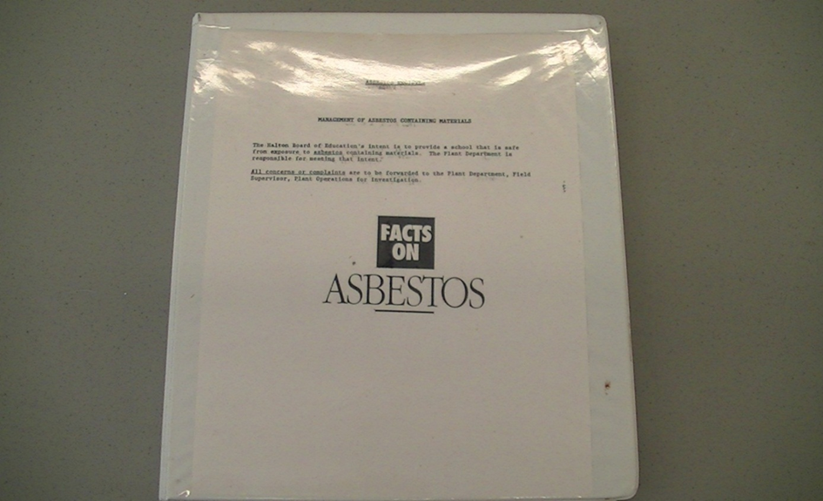
The Halton District School Board ensures that information is made available to all visiting individuals to HDSB buildings about Asbestos Containing Materials. This information is available in the school’s Asbestos Register, which is kept in the general office.

Slide 13

Surveys
Surveys refer to two applications in which asbestos has been used in schools:
Friable – refers to materials which can be easily crumbled such as pipe and tank insulation, sprayed on fireproofing, and acoustic and texture coat applications.
Non-Friable – refers to materials such as floor tile, fire-rated ceiling tile, gaskets, cement board, cement pipe, drywall joint compound, etc.
Please be aware that all fire doors are assumed to contain a friable asbestos insulation unless otherwise noted.

Slide 14
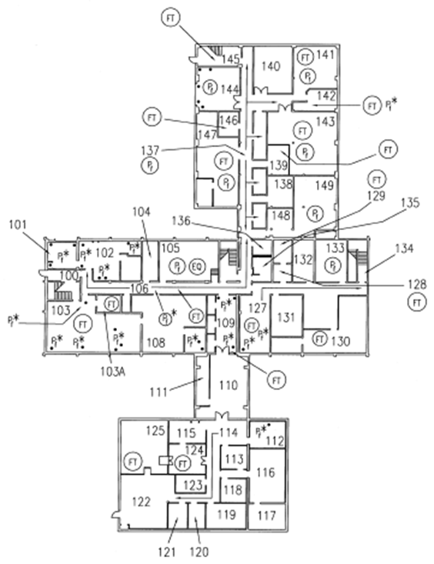
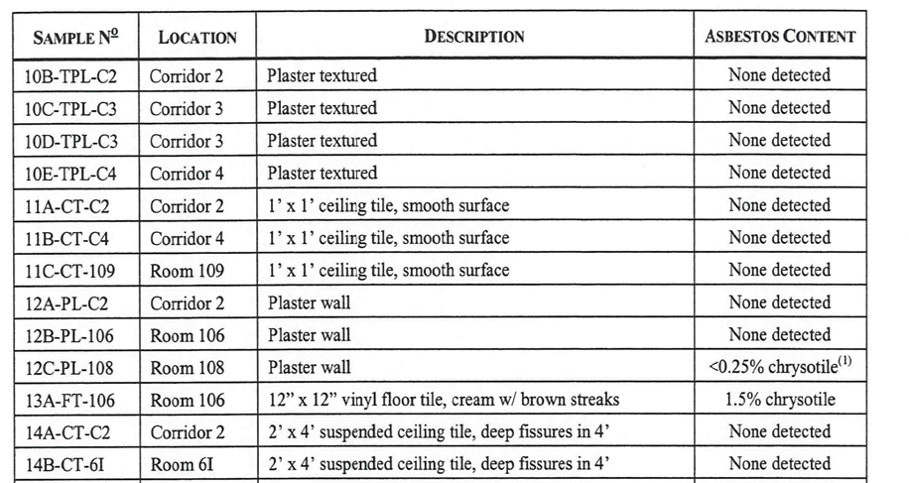
The Register
The register includes the Asbestos Containing Material Survey for rooms and areas, and a floor plan showing all the areas with Asbestos Containing Materials.

Slide 15
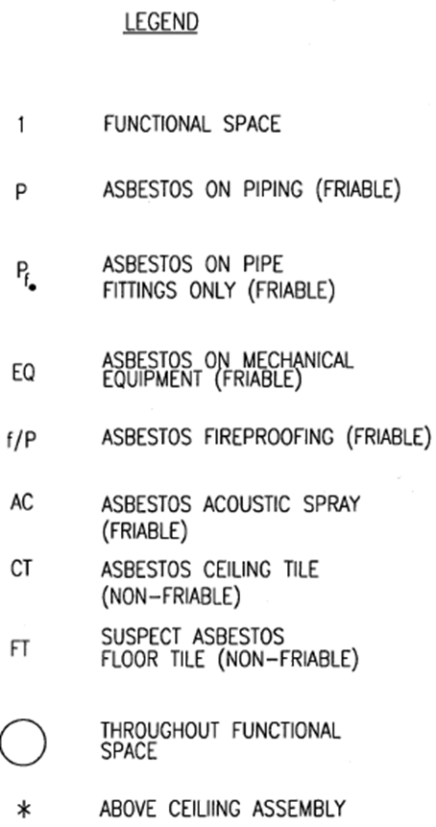
The Legend on each floor plan will indicate whether or not the asbestos containing material is “friable “ or “non-friable”.

Slide 16
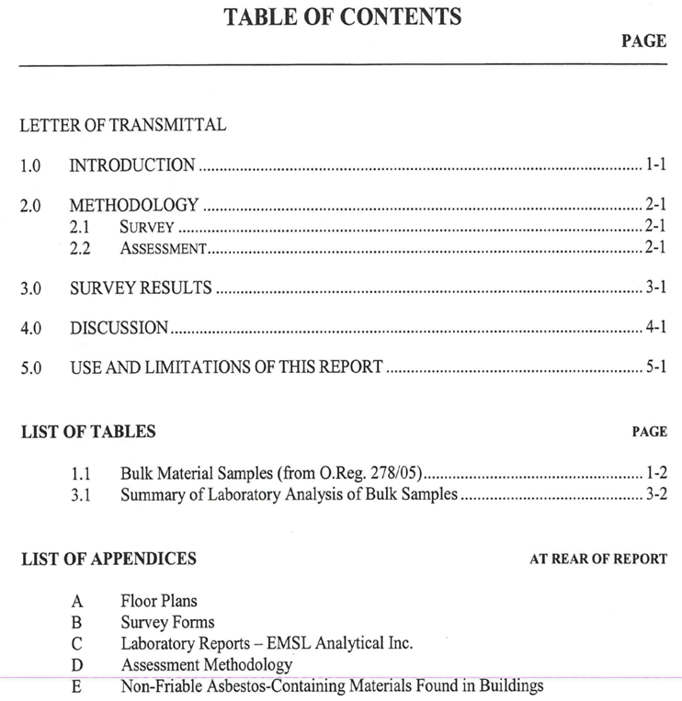
Every register is prefaced by a table of contents.

Slide 17

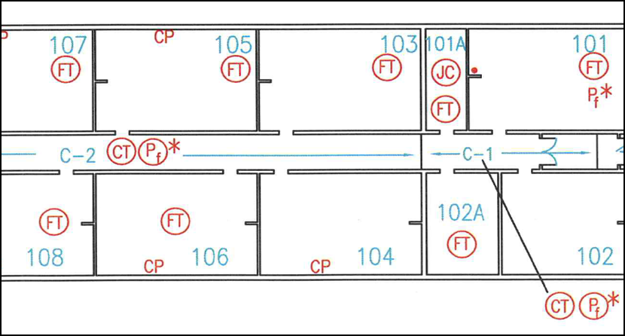
Every location in the left hand column of the survey can be located on the included floor plan

Slide 18

This table includes a description of the material and area tested.

Slide 19

Asbestos content levels are detailed in the last column

Slide 20
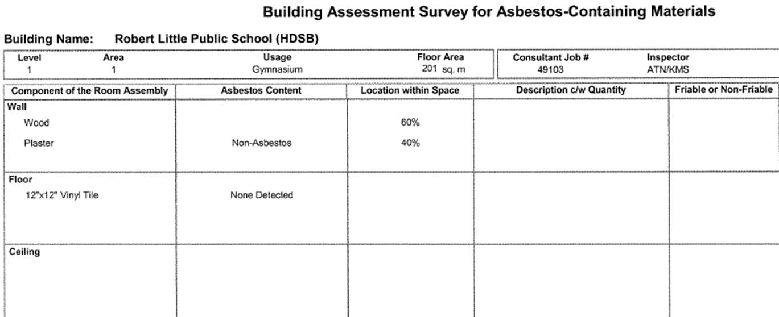
The Building Assessment Survey for Asbestos Containing Materials is a chart format breakdown of the school’s rooms and what materials in these rooms contain or may contain asbestos.

Slide 21
The locations labelled in the chart can be matched with the included labelled floor plan in order to identify what area is being described.

Slide 22
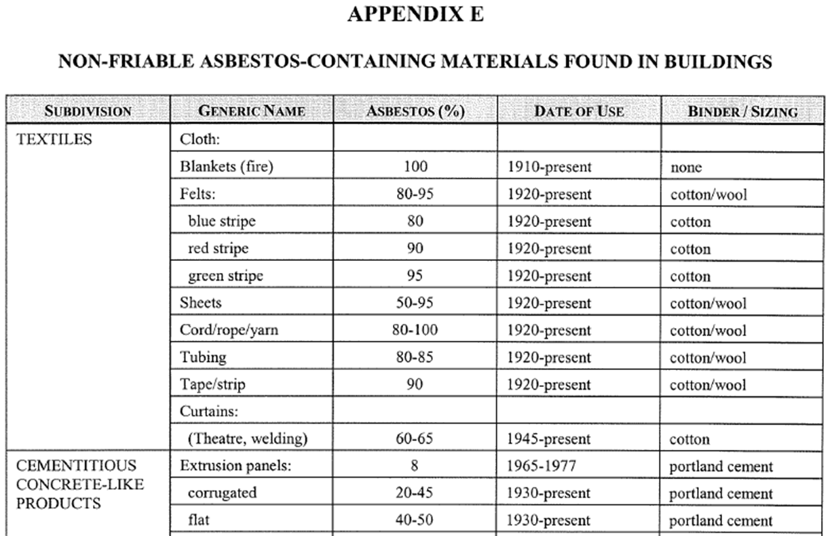
Appendix E is a list of non-friable asbestos containing materials found in the building.

Slide 23
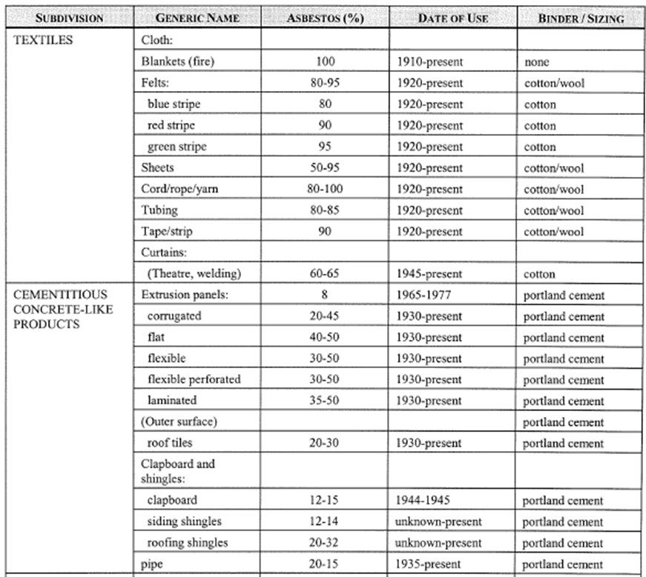
Each material that may contain or has been found to contain non-friable asbestos is listed here, and then broken down by sub-type material.

Slide 24
Inspections
Inspections are performed regularly to ensure that there are no
problems regarding any asbestos containing materials found in
any buildings. There are 3 types of inspections:
Annual Inspection – performed by Field Supervisor
Quarterly Inspection – performed by Head Caretaker
Above Ceiling Inspection – performed by a Qualified Consultant
Any deficiencies in need of repair through any discovery will be
addressed immediately.

Slide 25
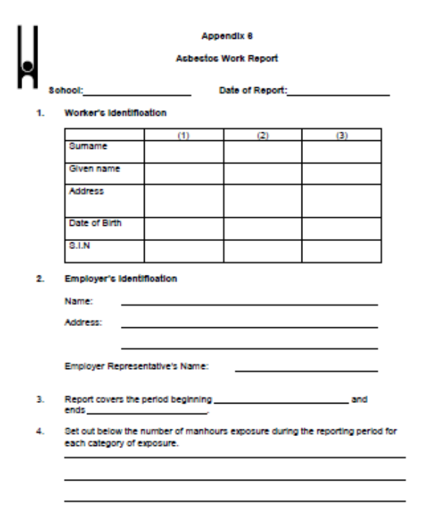
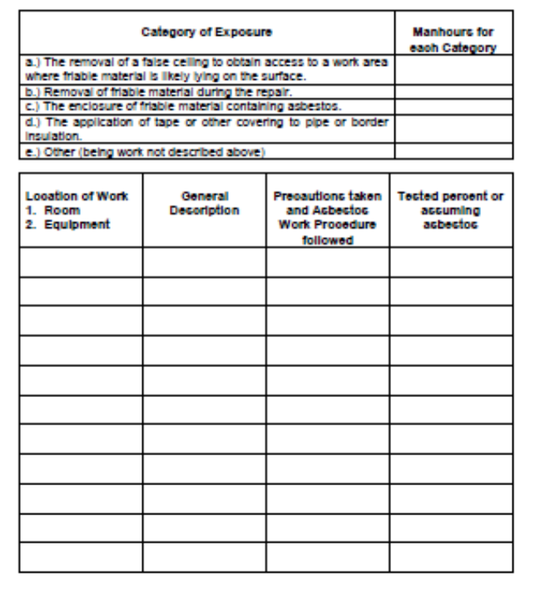
Any approved contractor performing type 2 or type 3 asbestos
abatement work is required to complete the Asbestos Work Report

Slide 26

Reporting
The Halton District School Board’s Asbestos Management Program is effective but is very much dependent on any deficiencies being reported immediately to the Facility Services Department.
Upon discovery of any damaged asbestos containing material:
Evacuate and Secure the area
Communicate with the Head Caretaker and School Administration Immediately

Slide 27
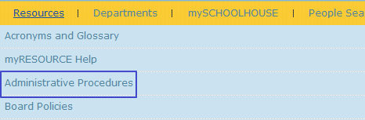


Need more Information?
To find out more about the Asbestos Management Program, simply Schoogle “Asbestos” on myHDSB. Or you can refer to the Administrative Procedures located under Resources. Look for Asbestos Management in Facilities under the Facility Services heading.

Slide 28
IMPORTANT!!!
Now that you have completed this training, click the confirm button below to submit the certificate of completion to our database.
CONFIRM

